Slide 1



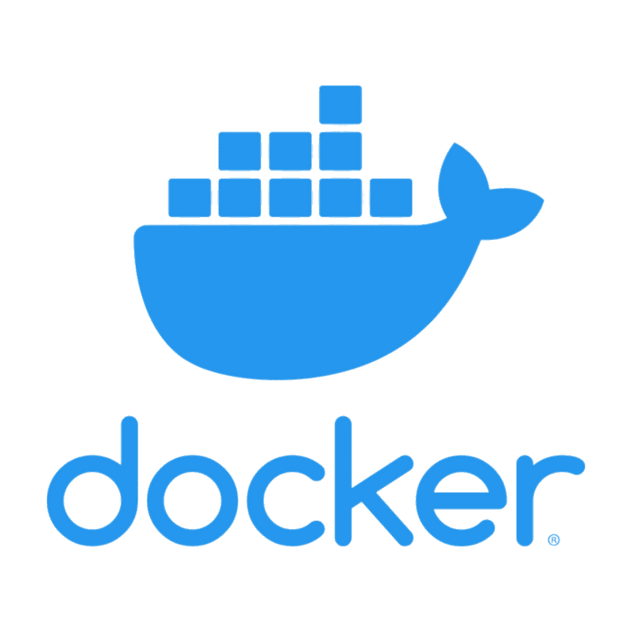
MLLIP
Exploring Docker Basics:
Running AI with Single Containers
Develop faster. Run anywhere.
@phyo-thi-ha

Slide 2
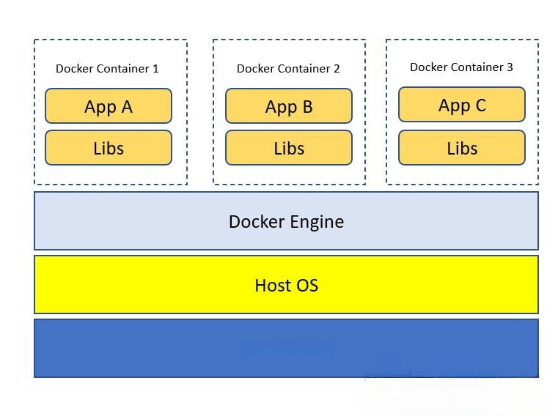
What is Docker?
Docker is an OS-level virtualization software platform that enables developers and IT administrators to create, deploy and run applications in a Docker Container with all their dependencies
Docker Container is a lightweight software package that includes all the dependencies (frameworks, libraries, etc.) required to execute an application.
Infrastructure

Slide 3
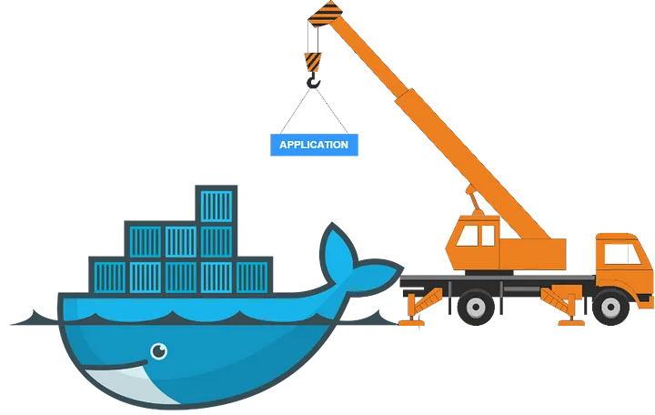
Virtual Machine vs Docker

Slide 4
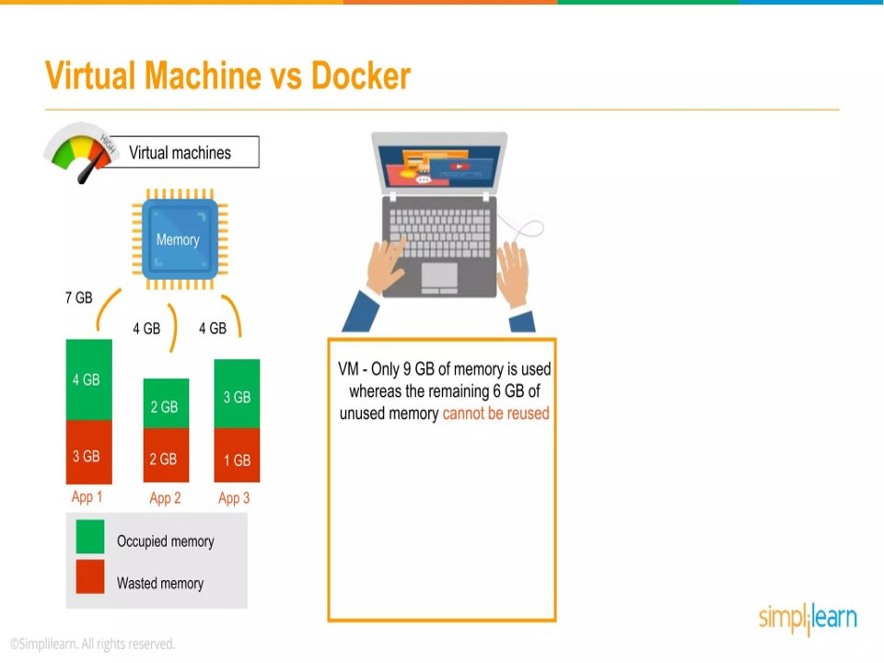

Slide 5
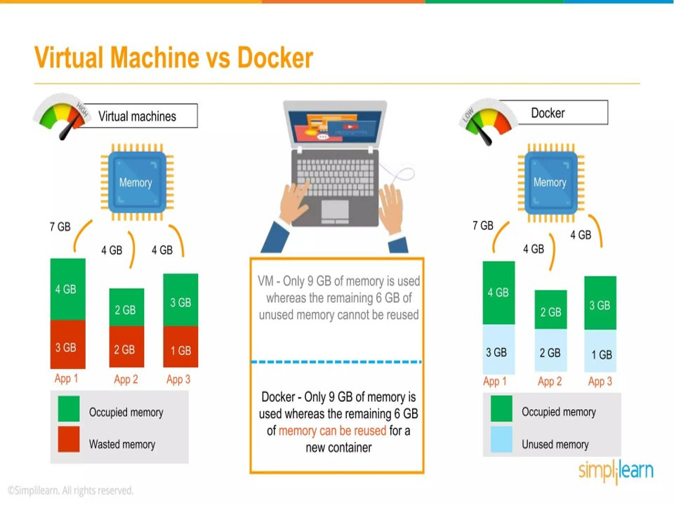

Slide 6
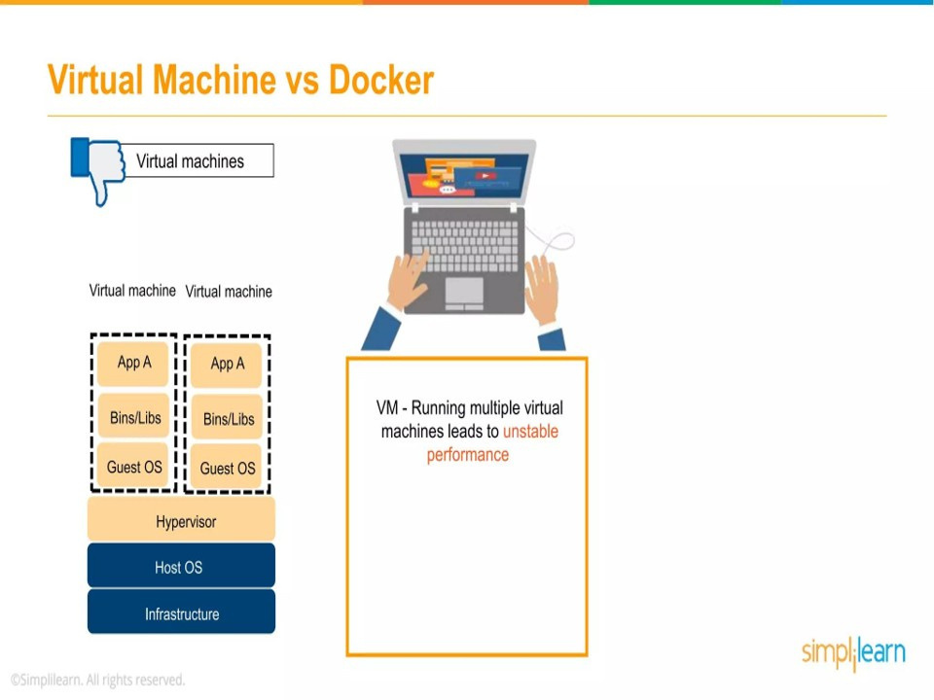

Slide 7
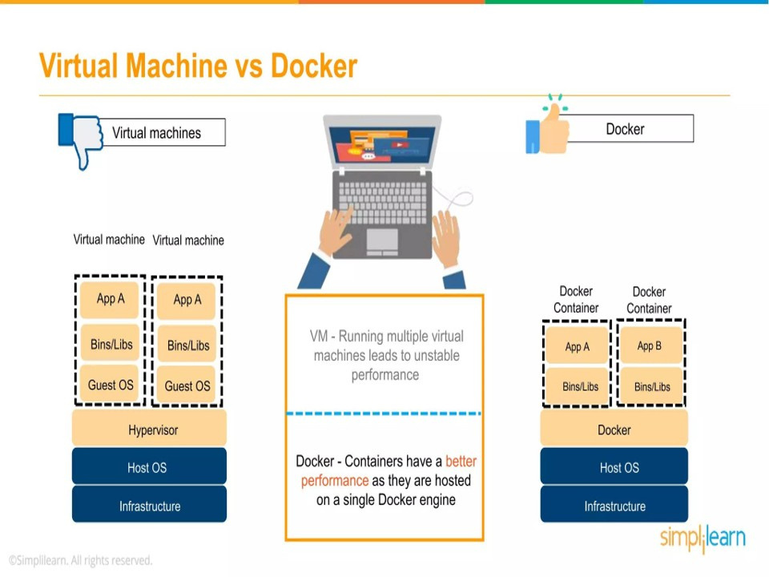

Slide 8
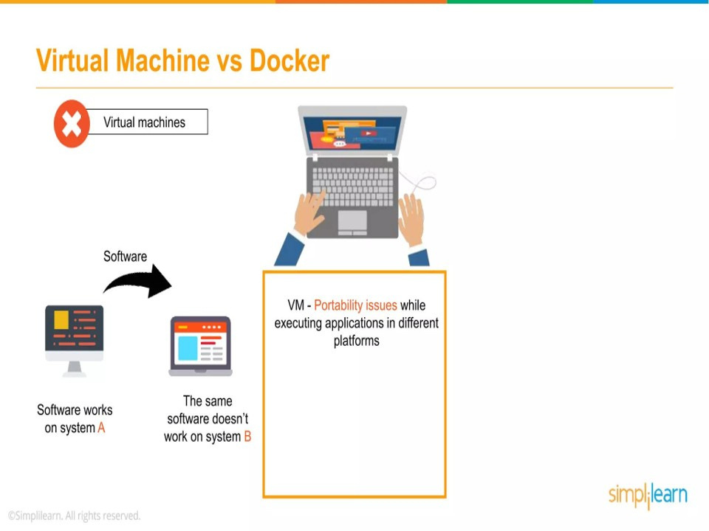

Slide 9
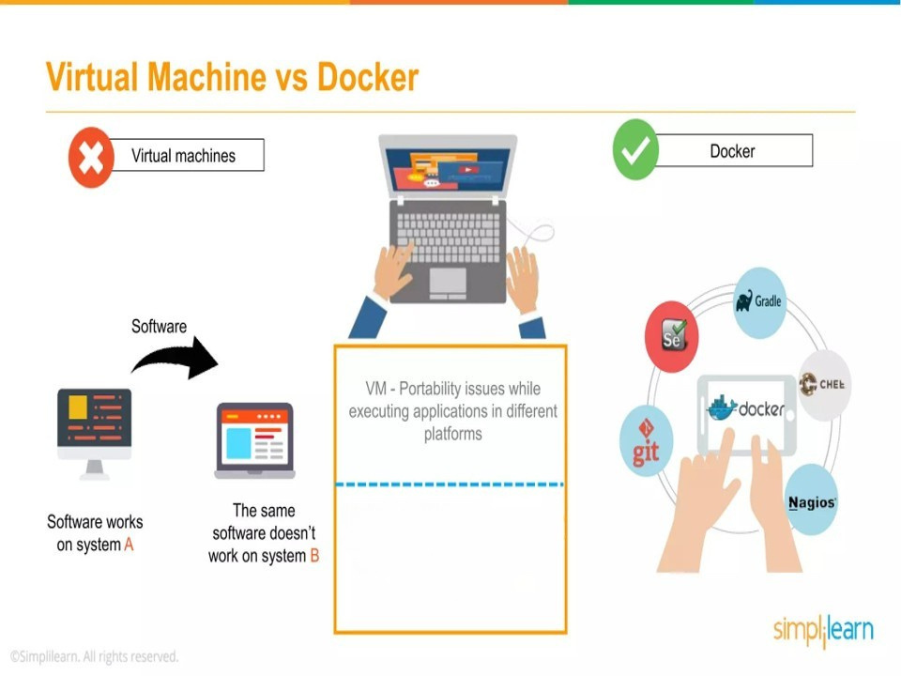
Docker - Applications can be encapsulated in containers and can be easily deployed to different system

Slide 10
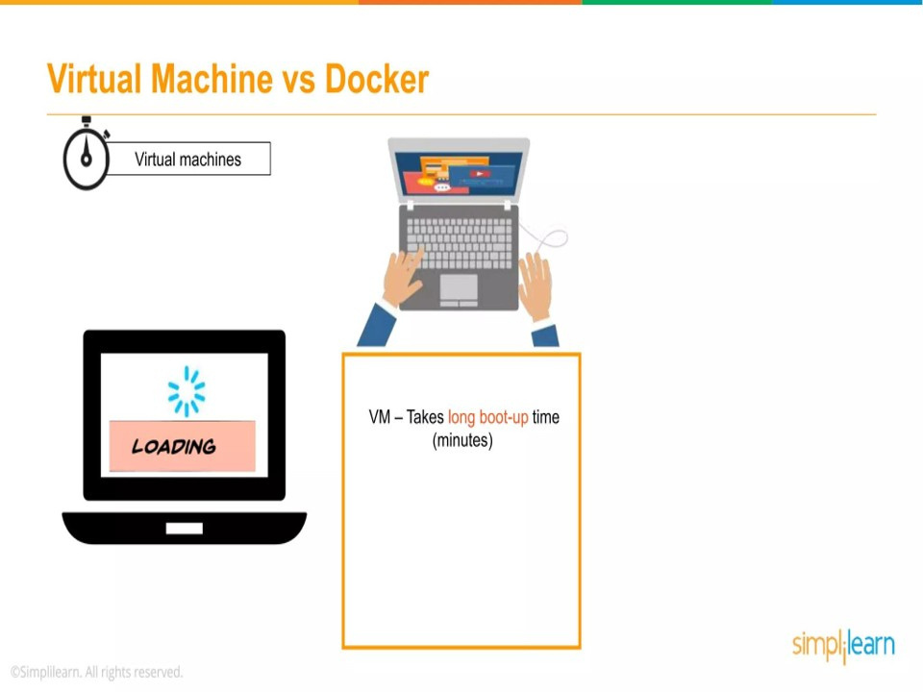

Slide 11
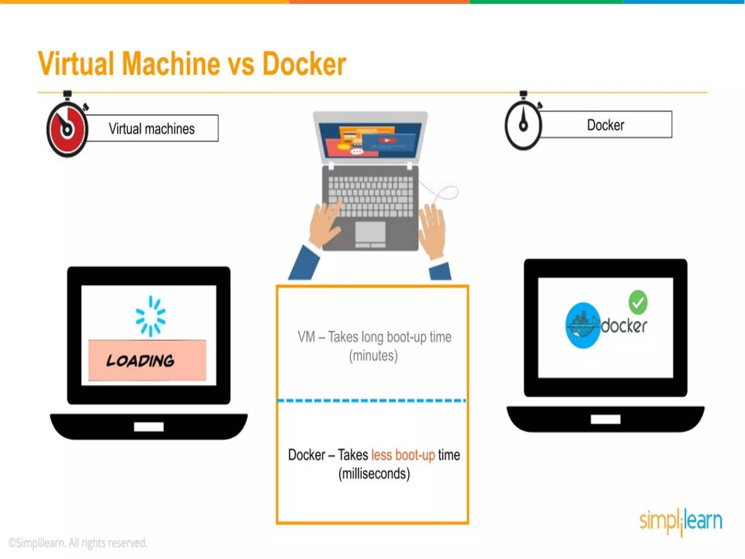

Slide 12
Components of Docker

Slide 13
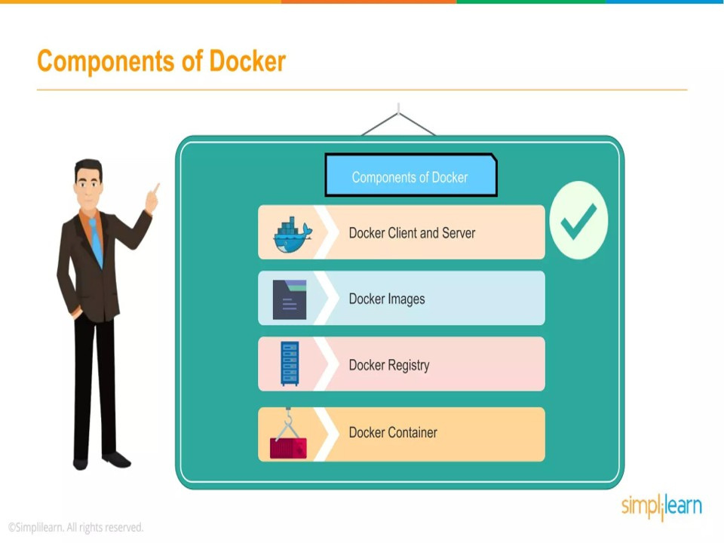

Slide 14
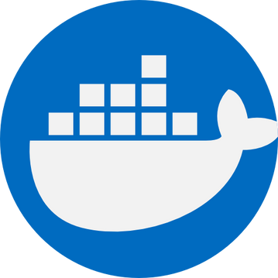

Docker Installation

Slide 15
https://devops-myanmar.gitbook.io/docker-quick-start/03-docker-install
https://docs.docker.com/desktop/setup/install/linux/ubuntu/

Slide 16
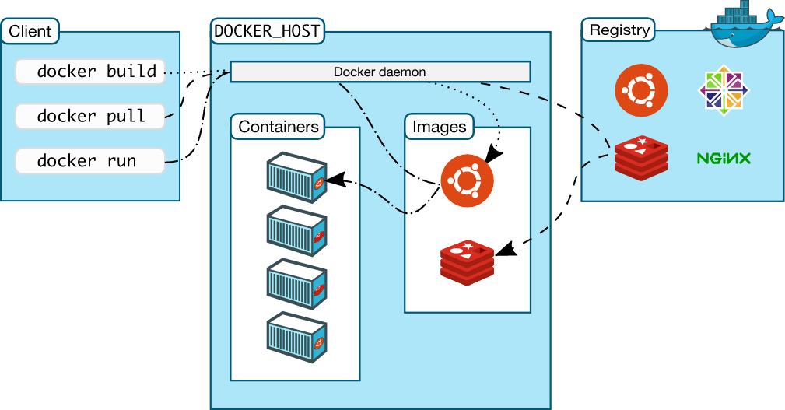
Docker Architecture

Slide 17
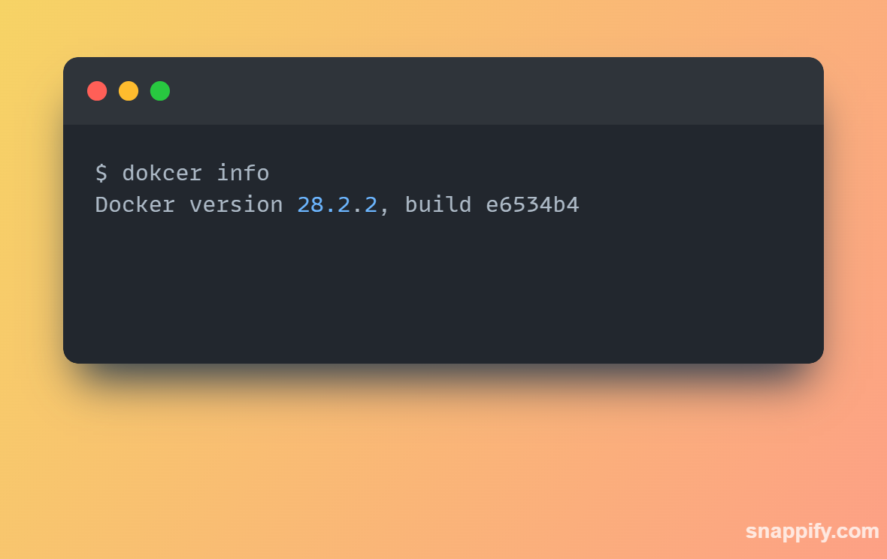
Ensuring Docker is ready

Slide 18
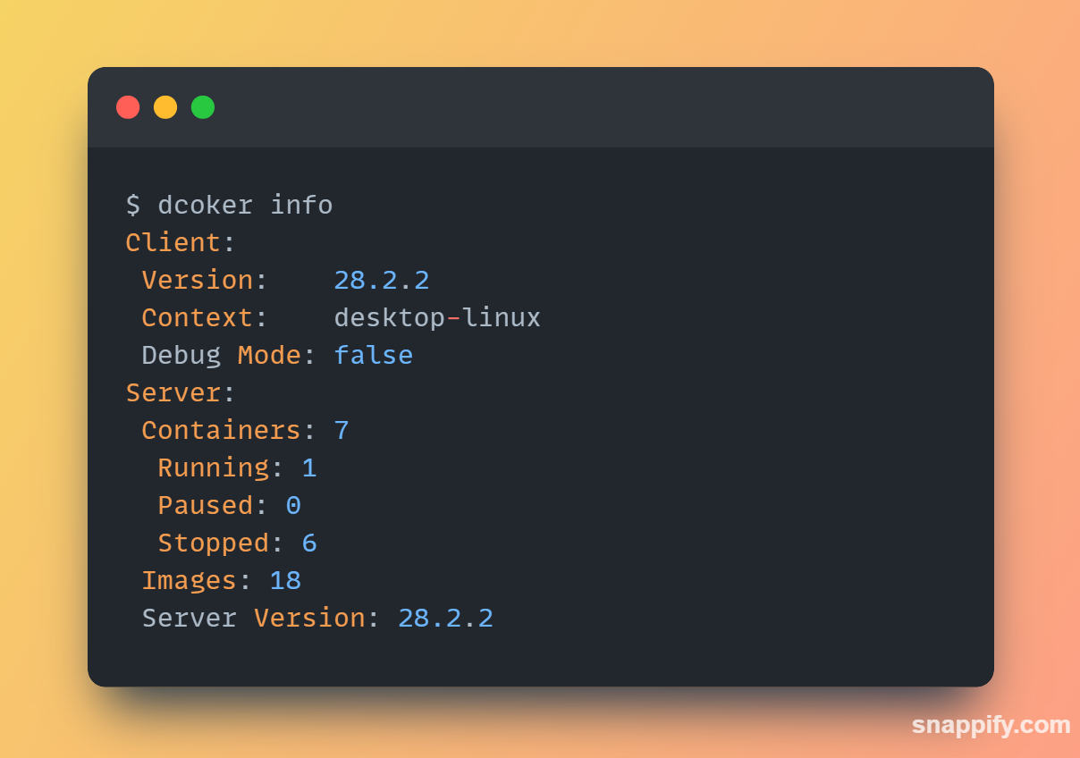
Ensuring Docker is ready

Slide 19

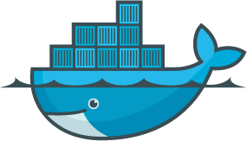
Getting started with
Docker

Slide 20
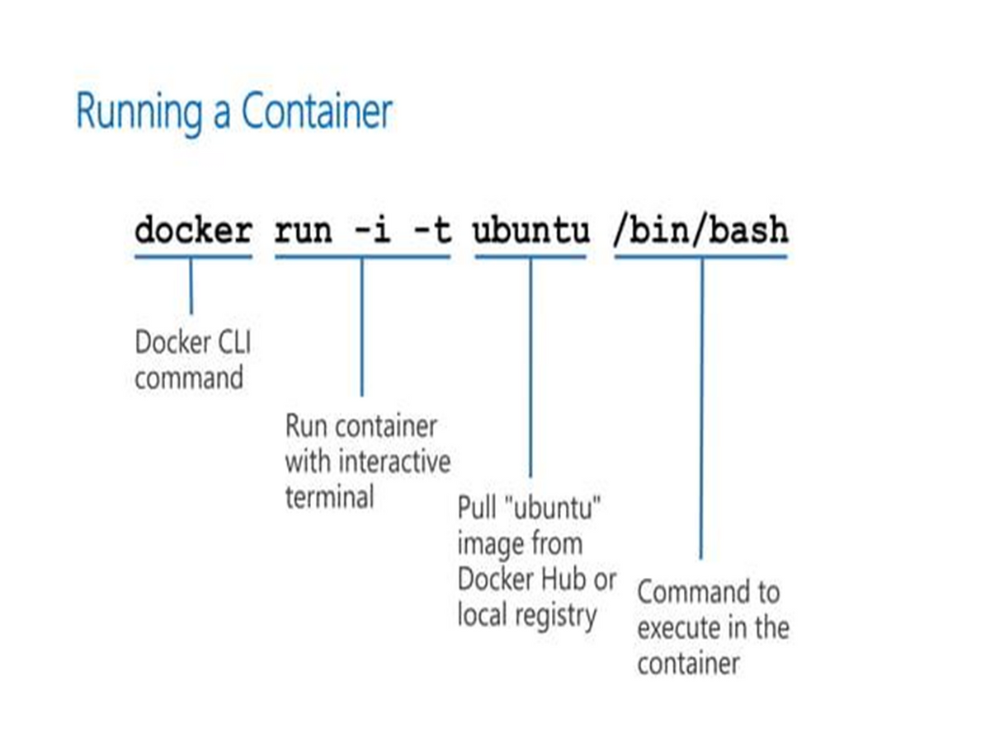
Running our first container

Slide 21
Running our first container
Flags
-i interactive STDIN ကိုဖွင့်ထားပေး
-t TTY flag container အတွက် pseudo-TTY တစ်ခုဖန်တီးပေး
-i -t (or) -it container ထဲမှာ command line ကနေ access လုပ်လို့ရမယ့် interactive shell တစ်ခု ဖန်တီးပေးတယ်
Note: -it မပါရင် interactive မဖြစ်ပဲ daemonized ဖြစ်သွားပါမယ်။

Slide 22
Interactive and Daemonized
daemonized service ဆိုတာ containerက နောက်ကွယ်က run နေမယ်
-d flag ကိုသုံးပါတယ်
web server or database လိုမျိုး ရေရှည် run ရမယ့် process တွေအတွက် အသုံးဝင်ပါတယ်

Slide 23
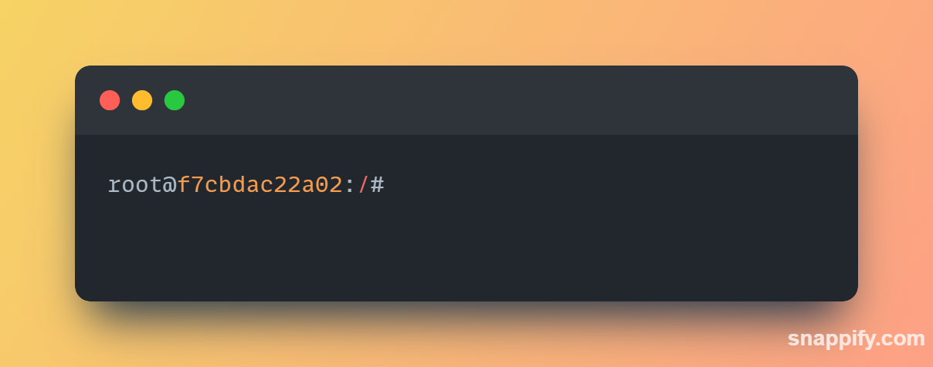
What was happening in the background
Docker က ubuntu image ကို local မှာ လိုက်ရှာ
local docker host မှာ မတွေ့ရင် Docker Hub မှာ လိုက်ရှာ
တွေ့ရင် Download ချလိုက်ပြီး local host မှာ သိမ်ထား
အဲဒီ image ကို သုံးပြီး new container ဆောက်
ပြီးတာနဲ့ /bin/bash ကို execute လုပ်

Slide 24
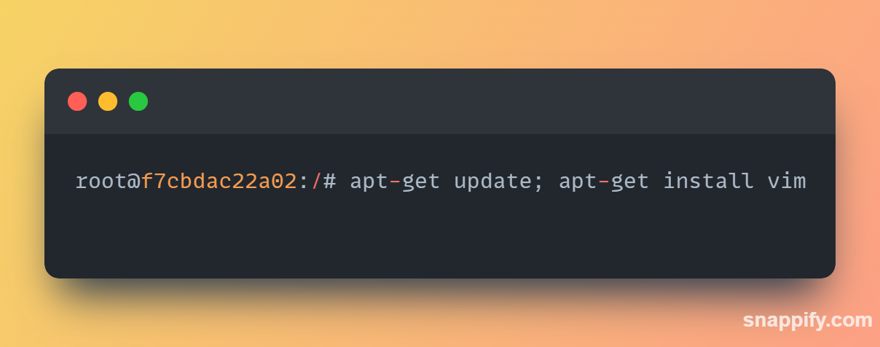
Installing a package in container

Slide 25
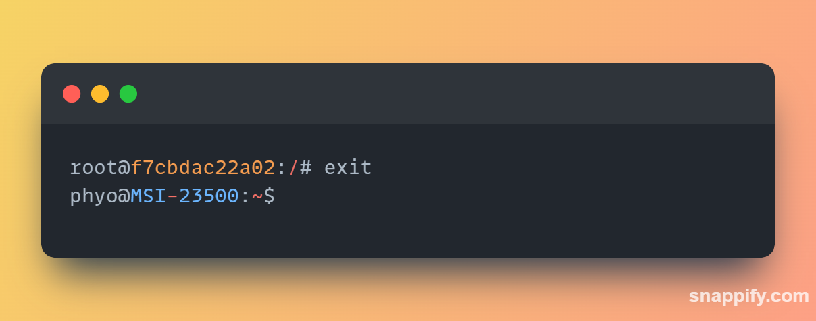
Exit and Stop container

Slide 26
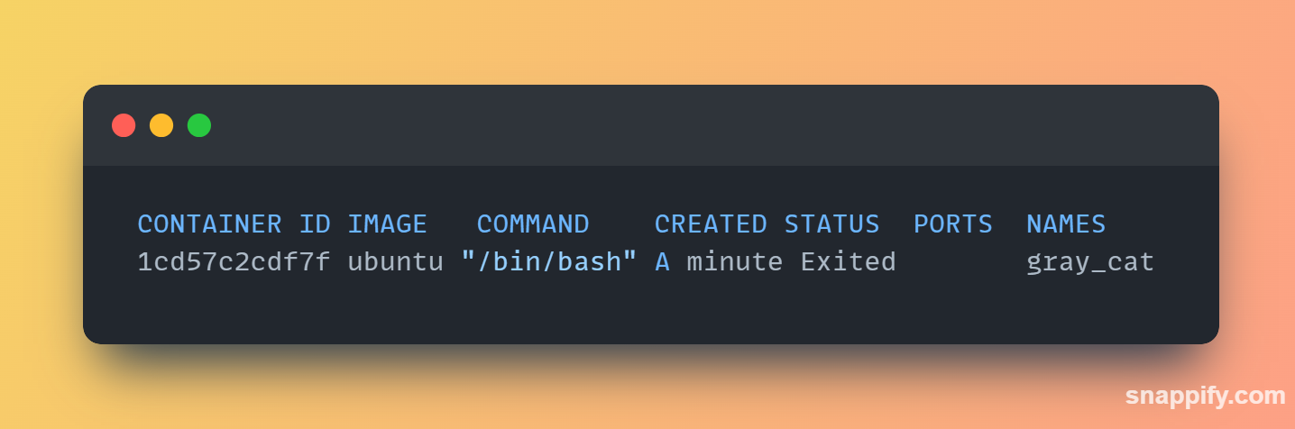
Listing Docker containers
docker ps will only show the running containers.
docker ps with -a flag will show us all containers, both stopped and running.

Slide 27
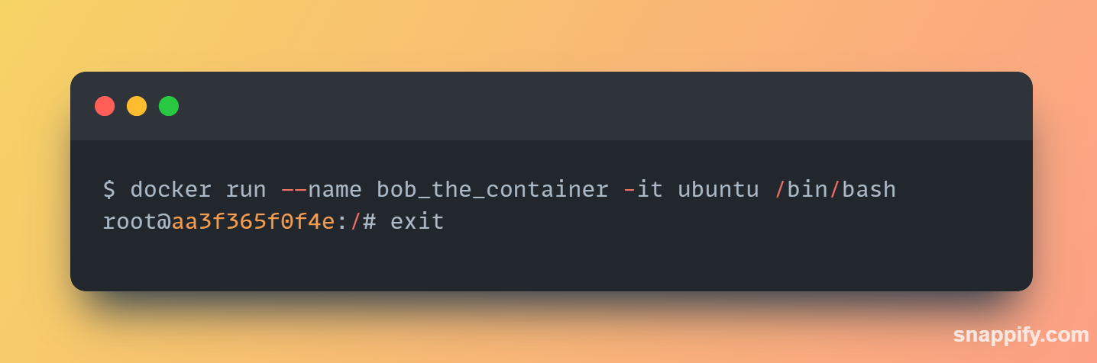
Container naming
Docker automatically generate a random name for each container.
Using --name flag, can specify a particular container name.
A valid container name can contain : a to z, A to Z, the digits 0 to 9, the underscore, period, and dash

Slide 28
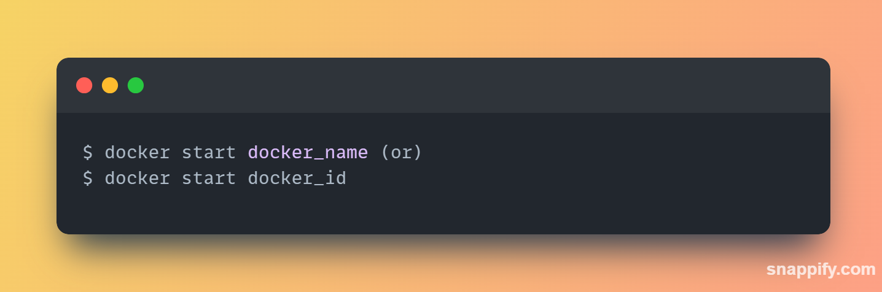
Starting a stopped container

Slide 29
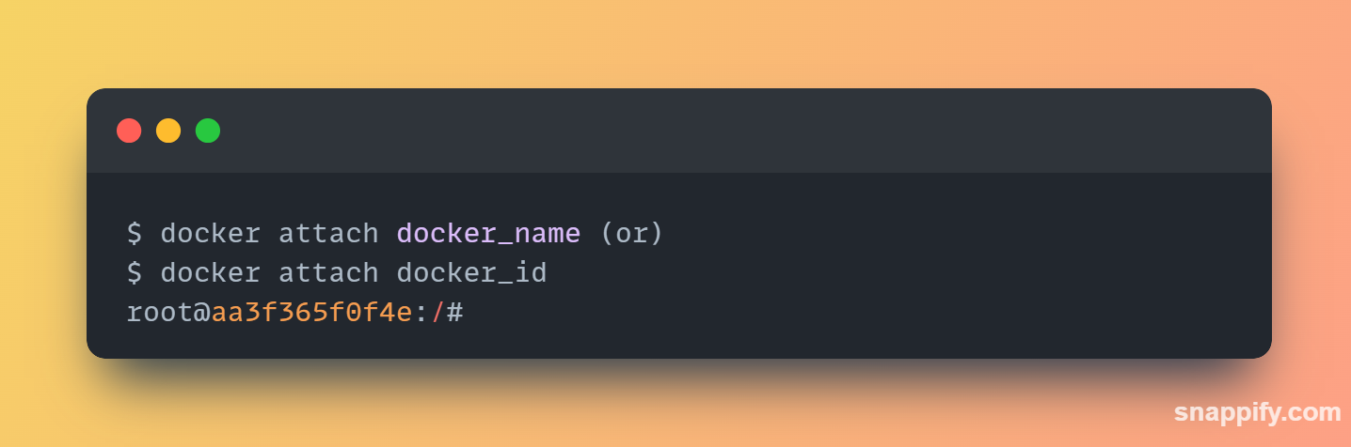
Attaching to a container

Slide 30
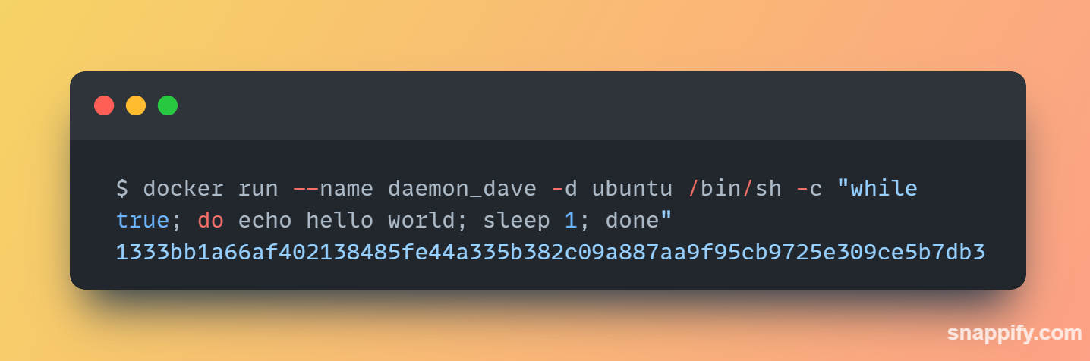
Creating daemonized containers
Use -d flag to detach the container to the background
Run docker ps to see running container

Slide 31
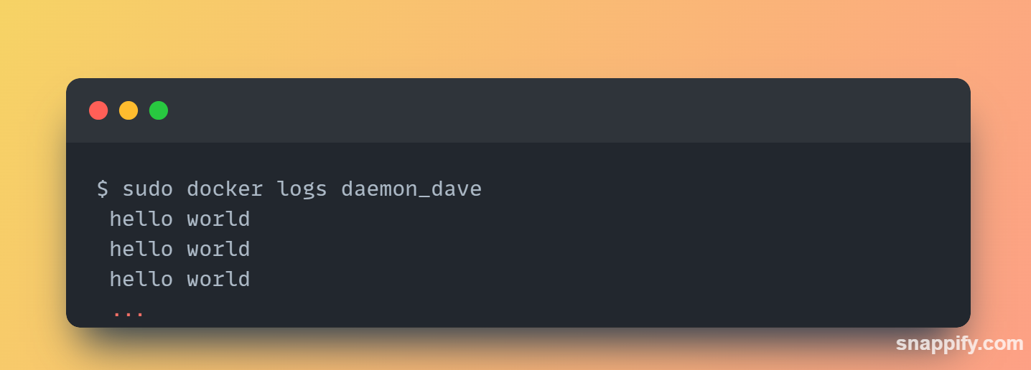
What’s happening inside container
The docker logs command fetches the logs of a container.

Slide 32
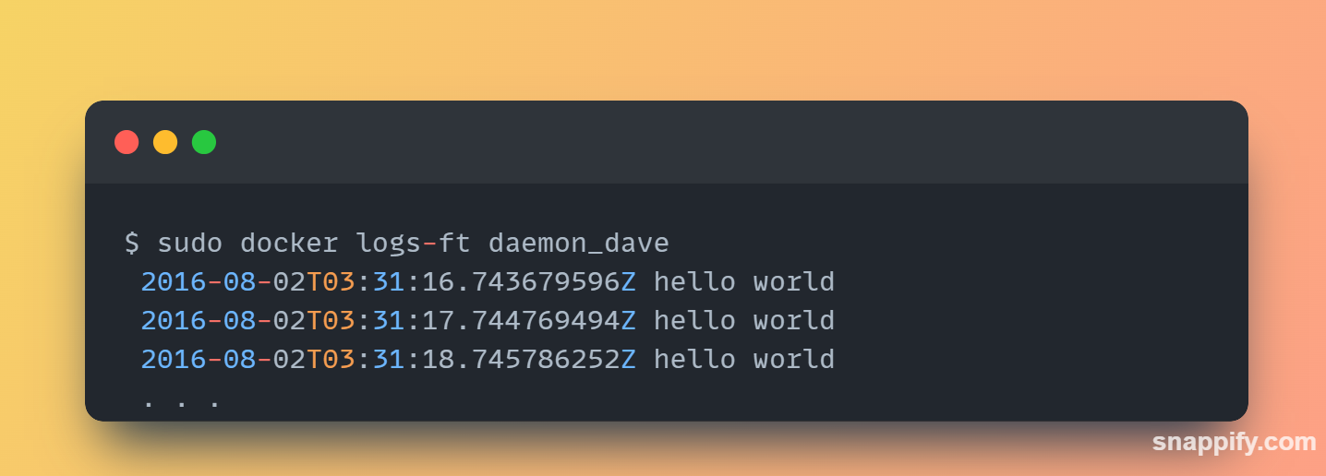
What’s happening inside container
docker log -f show realtime log. -t show with timestamp
log tail -n show n lines of log.

Slide 33
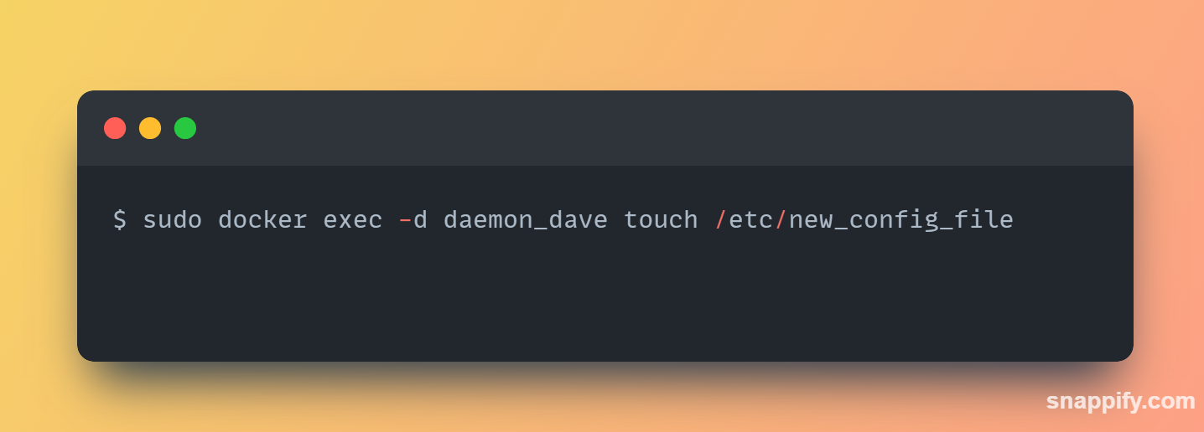
Running a process inside an already running container
we can also run additional processes inside our containers using the docker exec command. background and interactive.
-d flag indicates a background process.

Slide 34
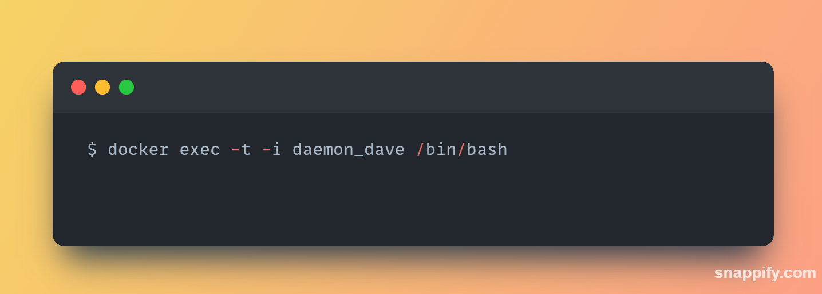
Running a process inside an already running container
-t and -i flags create a TTY and capture STDIN.

Slide 35
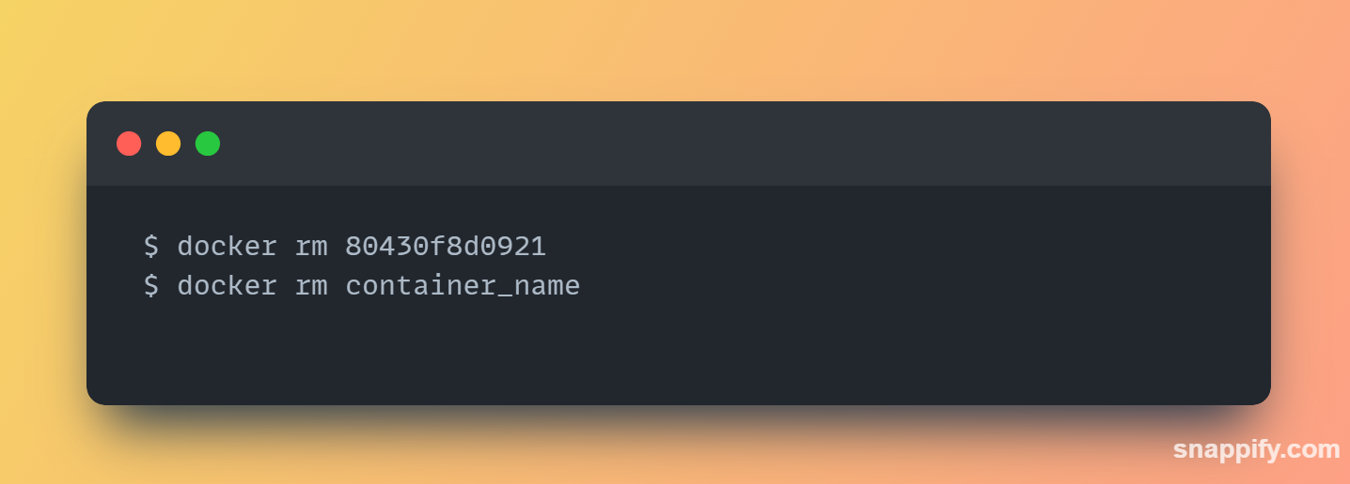
Deleting a container
docker ps -a -q . -q flag only returns container IDs.

Slide 36

Any
Questions?

